Slide 1


Slide 2
The Many Flavours Of Replication
A Walk-thru of the various methods
of PostgreSQL Replication

Slide 3
Timeline
8.0
9.0
9.1
9.2
9.4
10.0
|---------- Log Shipping ---------->
|--------------------------------- Streaming ------------------------->
|-------------------------- Logical ----------------->
Warm
Standby (PITR)
Hot
Standby
Cascading
Without Slots
With
Slots
|-------------------- Asynchronous ------------------->
|------------------------------- Synchronous Replication --------------------------------------->

Slide 4
Sending Servers
Master Server
Standby Servers
max_wal_senders
max_replication_slots
wal_keep_segments
wal_sender_timeout
track_commit_timestamp
synchronous_standby_names
vacuum_defer_cleanup_age
primary_conninfo
primary_slot_name
hot_standby
promote_trigger_file
max_standby_archive_delay
max_standby_streaming_delay
wal_receiver_status_interval
host_standby_feedback
wal_receiver_timeout
wal_retrieve_retry_interval
recovery_min_apply_delay
Subscribers
max_logical_replication_workers
max_sync_workers_per_subscription

Slide 5
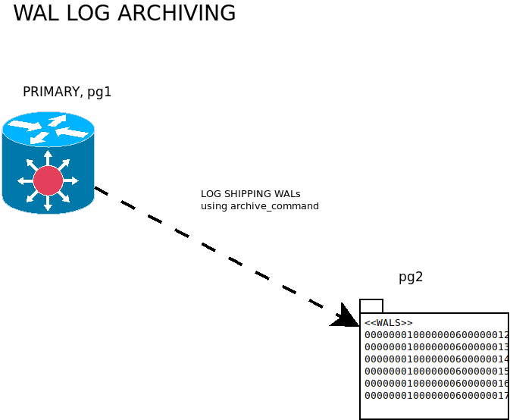

Slide 6
ssh postgres@pg1
-bash-4.2$ ssh-keygen
Generating public/private rsa key pair.
Enter file in which to save the key (/var/lib/pgsql/.ssh/id_rsa):
Enter passphrase (empty for no passphrase):
Enter same passphrase again:
Your identification has been saved in /var/lib/pgsql/.ssh/id_rsa.
Your public key has been saved in /var/lib/pgsql/.ssh/id_rsa.pub.
The key fingerprint is:
SHA256:7Ik+QQzwmZMrtW5HTtZAAEymAV5arTY8B0z5tZC4JmI postgres@pg1
The key's randomart image is:
...
# copy public key to hosts pg2 and pg3 ssh-copy-id postgres@pg2 ssh-copy-id postgres@pg3
Log Shipping
Generate public key for postgres on PRIMARY and copy to REPLICA

Slide 7
# Host pg2: Create WAL directory on REPLICA ssh postgres@pg2 mkdir -p $HOME/WAL exit
# Host pg1: setup WAL Log shipping
# as root, sudo as postgres ssh root@pg1 su - postgres
-- update system as superuser postgres alter system set archive_mode = on; alter system set archive_command = 'scp %p pg2:WAL/%f'; alter system set wal_keep_size = 100; alter system set wal_log_hints = 'on';
# as root, restart postgres service systemctl restart postgresql@14-main
Log Shipping Cont’d

Slide 8
-- Host pg1: Generate WALS
-- Login pg1, as postgres superuser and perform the following dropdb database if exists db01; create database db01;
\c db01 select *,'hello world'::text as comments into table t1 from (select * from generate_series(1,1e6))t;
-- Flush data files to disk checkpoint;
-- Force switch to a new write-ahead log file select pg_walfile_name(pg_switch_wal());
# Host pg1: remote LOGIN host pg2 su - postgres ssh postgres@pg2 ls -l WAL
Log Shipping Cont’d

Slide 9
pg_basebackup --help
Usage: pg_basebackup [OPTION]...
Options controlling the output:
-D, --pgdata=DIRECTORY receive base backup into directory
-F, --format=p|t output format (plain (default), tar)
-r, --max-rate=RATE maximum transfer rate to transfer data directory
(in kB/s, or use suffix "k" or "M")
-R, --write-recovery-conf write configuration for replication
-T, --tablespace-mapping=OLDDIR=NEWDIR relocate tablespace in OLDDIR to NEWDIR
--waldir=WALDIR location for the write-ahead log directory
-X, --wal-method=none|fetch|stream include required WAL files with specified method
-z, --gzip compress tar output
-Z, --compress=0-9 compress tar output with given compression level
General options:
-c, --checkpoint=fast|spread set fast or spread checkpointing
-C, --create-slot create replication slot
-l, --label=LABEL set backup label
-n, --no-clean do not clean up after errors
-N, --no-sync do not wait for changes to be written safely to disk
-P, --progress show progress information
-S, --slot=SLOTNAME replication slot to use
-v, --verbose output verbose messages
-V, --version output version information, then exit
--no-slot prevent creation of temporary replication slot
--no-verify-checksums do not verify checksums
-?, --help show this help, then exit
Backups
About Basebackups

Slide 10
Connection options:
-d, --dbname=CONNSTR connection string
-h, --host=HOSTNAME database server host or socket directory
-p, --port=PORT database server port number
-s, --status-interval=INTERVAL time between status packets sent to server (in seconds)
-U, --username=NAME connect as specified database user
-w, --no-password never prompt for password
-W, --password force password prompt (should happen automatically)
Backups Cont’d

Slide 11
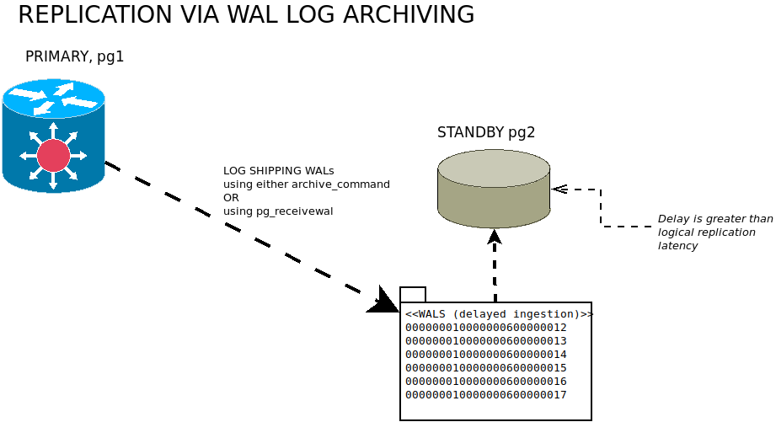
ssh postgres@pg1
Log Shipping Replication

Slide 12
# Confirm remote connectivity access
# on pg1: check for listening service
[root@pg1 ~]# netstat -tlnp
Active Internet connections (only servers)
Proto Recv-Q Send-Q Local Address Foreign Address State PID/Program name tcp 0 0 0.0.0.0:22 0.0.0.0:* LISTEN 297/sshd tcp 0 0 0.0.0.0:5432 0.0.0.0:* LISTEN 1629/postmaster tcp6 0 0 :::22 :::* LISTEN 297/sshd tcp6 0 0 :::5432 :::* LISTEN 1629/postmaster
# on pg2: attempt test login
[root@pg2 ~] psql 'host=pg1 user=postgres password=postgres' -c "select 1 as ping" ping
------
1
# Check Server Status On Host pg2
Method 1: systemctl status postgresql-14 # CENTOS systemctl status postgresql@14-main # Ubuntu
Method 2: ps aux | grep postgres
Replication Via Log Shipping

Slide 13
# Delete any pre-existing data cluster systemctl stop postgresql@14-main rm -rf /var/lib/postgreql/14/data/*
# Perform BaseBackup su - postgres export PGDATA=/var/lib/postgresql/14/main cd $HOME
/usr/bin/pg_basebackup -d 'host=pg1 user=postgres password=postgres port=5432' \
--wal-method=stream \
-c fast \
-l basebackup \
-D /var/lib/postgresql/14/main \
-P -v
# Configure REPLICA echo " hot_standby = 'on' recovery_target_timeline = 'latest' restore_command='cp /var/lib/postgresql/WAL/%f "%p"' archive_cleanup_command = 'pg_archivecleanup /var/lib/postgresql/WAL %r'
" >> /var/lib/postgresql/14/main/postgresql.auto.conf touch /var/lib/postgresql/14/main/standby.signal
Replication Via Log Shipping Cont’d

Slide 14
# As root: REPLICA service start systemctl start postgresql@14-main
------------------------------------------------------------------ netstat -tlnp
Active Internet connections (only servers)
Proto Recv-Q Send-Q Local Address Foreign Address State PID/Program name tcp 0 0 0.0.0.0:22 0.0.0.0:* LISTEN 297/sshd tcp 0 0 0.0.0.0:5432 0.0.0.0:* LISTEN 867/postmaster tcp6 0 0 :::22 :::* LISTEN 297/sshd tcp6 0 0 :::5432 :::* LISTEN 867/postmaster
# Create table and populate records on host pg1
SQL="select * into table t2 from generate_series(1,1e6)" psql 'host=pg1 dbname=db01 user=postgres password=postgres'<<<$SQL psql 'host=pg1 dbname=db01 user=postgres password=postgres' -c 'checkpoint;select pg_switch_wal()'
# Confirm replication on host pg2
[root@pg2 ~] psql 'host=pg2 dbname=db01 user=postgres password=postgres' -c '\dt+'
List of relations
Schema | Name | Type | Owner | Size | Description
--------+------+-------+----------+-------+------------- public | t1 | table | postgres | 50 MB | public | t2 | table | postgres | 35 MB |
Replication Via Log Shipping Cont’d

Slide 15
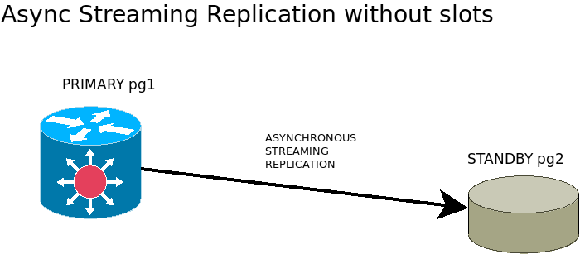
Streaming Replication Without Slots

Slide 16
# Execute on PRIMARY, host pg1
-- Add a replicating ROLE create role replicant with login replication password 'mypassword';
--
-- enable streaming replication alter system set wal_level = 'replica';
# as root; reload the service on PRIMARY pg1 systemctl reload postgresql@14-main
-- Execute on REPLICA, host pg2
-- point REPLICA to PRIMARY alter system set primary_conninfo = 'host=pg1 user=replicant password=mypassword';
# as root; restart the service on REPLICA pg2 systemctl restart postgresql@14-main
Replication Via Streaming
Without Slots

Slide 17
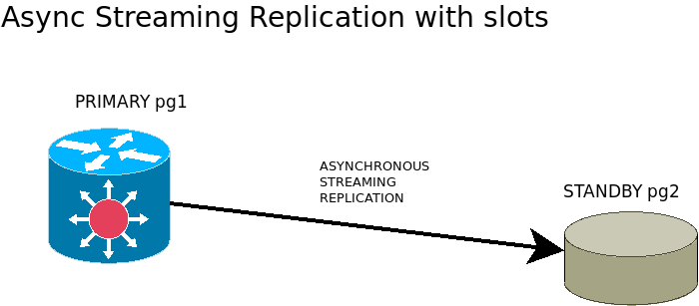
Streaming Replication With Slots

Slide 18
# Execute on PRIMARY, host pg1 select pg_create_physical_replication_slot('pg2');
# Execute on REPLICA, host pg2
-- point REPLICA to PRIMARY using slot alter system set primary_slot_name = 'pg2'
----------------------------------------------------
# as root; restart the service on REPLICA pg2 systemctl restart postgresql@14-main
# Execute on PRIMARY, host pg1
# confirm replication slot is active postgres=# select slot_name, slot_type, active, active_pid from pg_replication_slots; slot_name | slot_type | active | active_pid
-----------+-----------+--------+------------ pg2 | physical | t | 2313
Replication Via Streaming
With Slots
METHOD 1: update existing configuration

Slide 19
As root: execute the following on REPLICA pg2
- Stop the service
- Delete the data cluster
- Create a new basebackup using slots, it's assumed no physical slot has already been created on PRIMARY
export PGDATA=/var/lib/pgsql/14/data # CENTOS export PGDATA=/var/lib/postgresql/14/main # Ubuntu
# PGDATA environment variable assumes CENTOS systemctl stop postgresql@14-main su - postgres rm -rf $PGDATA
/usr/bin/pg_basebackup -d 'host=pg1 user=postgres password=postgres port=5432' \
--wal-method=stream \
-l basebackup \
-D $PGDATA \
-R -P -v \
--create-slot \
--slot=pg2 touch $PGDATA/standby.signal
Replication Via Streaming
With Slots
METHOD 2: generate new basebackup

Slide 20
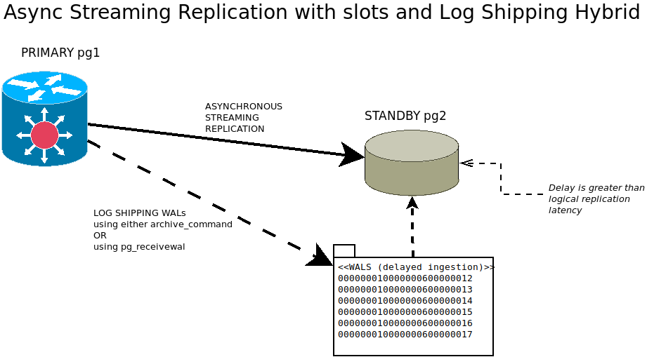

Slide 21
# Standby Mode: (requires a server restart)
– Warm Standby (No Read) alter system set hot_standby=’off’;
– Hot Standby (DEFAULT: Read-Only) alter system set hot_standby=’on’;
PostgreSQL Replication
Variations

Slide 22
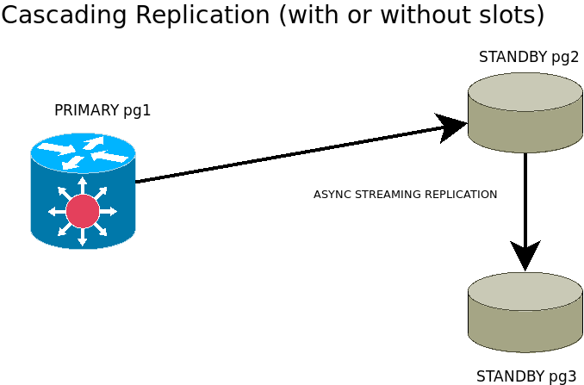
Variations Cont’d
Cascading Replication

Slide 23
Perform BaseBackup systemctl stop postgresql@14-main su - postgres export PGDATA=/var/lib/postgresql/14/main rm -rf $PGDATA
# host is changed from pg1 to pg2
/usr/bin/pg_basebackup -d 'host=pg2 user=postgres password=postgres port=5432' \
--wal-method=stream \
-l basebackup \
-D /var/lib/postgresql/14/main \
-R -P -v \
--create-slot \
--slot=pg3
Configure CASCADED REPLICA, valid for pg ver 12+ touch $PGDATA/standby.signal
Cascading Replication
Example

Slide 24
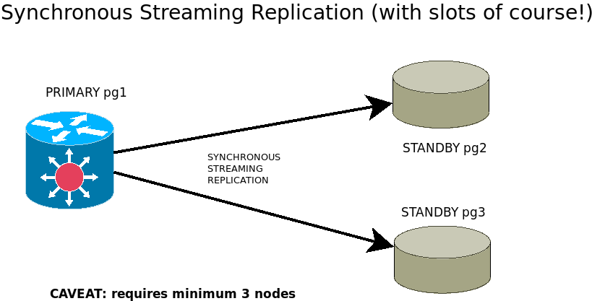
Synchronous Replication

Slide 25
- Asynchronous replication is non-blocking and returns as soon as the transaction is committed on the PRIMARY.
- Synchronous replication commits a transaction only when the operation completes on the slave(s).
----------------------------------------------------------------------------------------
#synchronous_standby_names = '' # SYNC ORDER
# num_sync is the number of synchronous standbys
# that transactions need to wait for replies from
#
# '*' OR 'all'
# [FIRST] num_sync ( standby_name [, ...] )
# ANY num_sync ( standby_name [, ...] )
# standby_name [, ...]
#
----------------------------------------------------------------------------------------
#synchronous_commit = on # synchronization level;
# off # synchronous replication is ignored
#
# local # guaranteed data flush only on the primary node
#
# remote_write # commit waits for confirmation from standby
# writing the record (not yet flushed)
#
# remote_apply # standby replies when the commit record is replayed
#
# on # waits until data is flushed
# to the transaction log on all hosts
---------------------------------------------------------------------------------------- cluster_name (string) # Sets a name that identifies this database cluster.
Async vs Sync Replication

Slide 26
HOST=PG2
# TIP: set cluster_name=pg2
/usr/bin/pg_basebackup -d 'host=pg1 user=postgres password=postgres port=5432 application_name=pg2' \
--wal-method=stream \
-l basebackup \
-D /var/lib/postgresql/14/main \
-R -P -v \
--create-slot \
--slot=pg2 echo "cluster_name = 'pg2'" >> /var/lib/postgresql/14/main/postgresql.auto.conf touch $PGDATA/standby.signal
HOST=PG3
# TIP: set cluster_name=pg3
/usr/bin/pg_basebackup -d 'host=pg1 user=postgres password=postgres port=5432 application_name=pg3' \
--wal-method=stream \
-l basebackup \
-D /var/lib/postgresql/14/main \
-R -P -v \
--create-slot \
--slot=pg3 echo "cluster_name = 'pg3'" >> /var/lib/postgresql/14/main/postgresql.auto.conf touch $PGDATA/standby.signal
Synchronous Replication
Example

Slide 27
HOST=PG1
# default = on, requires restart show synchronous_commit;
# requires reload alter system set synchronous_standby_names='pg2,pg3'; select pg_reload_conf();
# validate select application_name,state,sync_state from pg_stat_replication order by 1; application_name | state | sync_state
------------------+-----------+------------ pg2 | streaming | sync pg3 | streaming | potential
Example Alternative Replication Wait Modes alter system set synchronous_standby_names='FIRST 1 (pg3,pg2)'; alter system set synchronous_standby_names='FIRST 2 (pg3,pg2)'; alter system set synchronous_standby_names='ANY 2 (pg3,pg2)';
Synchronous Replication
Example Cont’d

Slide 28
Basebackup behaviour: log shipping versus streaming (with and without slots)
Monitor:
PRIMARY: select * from pg_stat_replication; select * from pg_replication_slots; select * from pg_get_replication_slots();
REPLICA: postgres logs cat <postgres log> | grep -E 'ERROR|FATAL'
Slot administration:
CLI: pg_receivewal
FUNCTIONS: pg_drop_replication_slot pg_copy_physical_replication_slot pg_create_physical_replication_slot pg_replication_slot_advance
Synchronous Replication Caveat

Slide 29
About
A method of replicating data objects and their changes, based upon their replication identity (usually a primary key). While streaming replication uses exact block addresses, logical replication is byte-by-byte.
Logical replication uses a publish and subscribe model with one or more subscribers subscribing to one or more publications on a publisher node. Subscribers pull data from the publications they subscribe to and may subsequently re-publish data to allow cascading replication or more complex configurations.
Capabilities
- UPGRADE: Upgrade PostgreSQL from 9.4 to 9.5, without downtime
- SCALE OUT: Copy all or a selection of database tables to other nodes in a cluster
- AGGREGATE: Accumulate changes from sharded database servers into a Data Warehouse
- INTEGRATE: Feed database changes in real-time to other systems
- PROTECT: Provide backup or high availability for clusters, replacing earlier technologies
Method
Logically replicating a table starts with snapshot of the data from the publisher database and copying that to the subscriber database.
Changes on the publisher are sent to the subscriber real-time and is applied in the same order.
Logical Replication

Slide 30
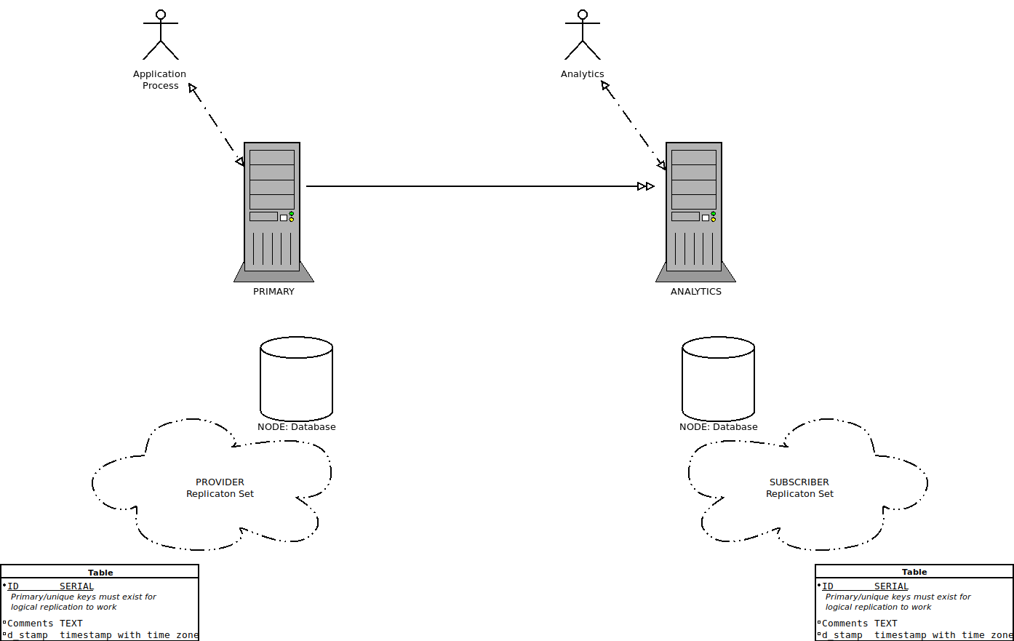
Logical Replication

Slide 31
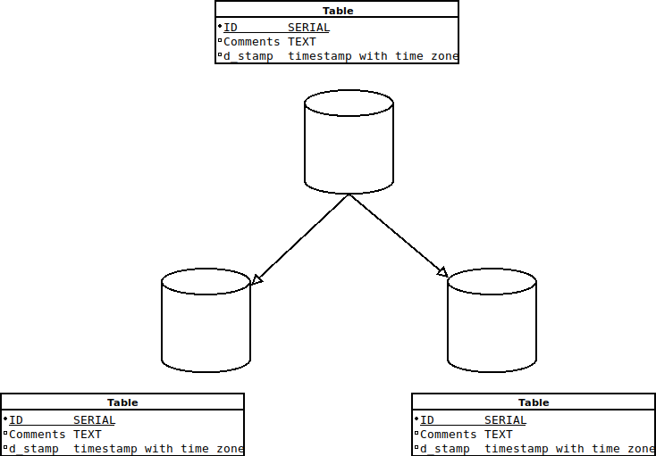
Logical Replication

Slide 32
Method
- create the database(s)
- create two schemas
- create and populate table(s)
- create the logical node(s)
- create replication set(s)
- subsribe to provider(s)
- peform DML operations
CREATE PUBLICATION name
[ FOR TABLE [ ONLY ] table_name [ * ] [, ...]
| FOR ALL TABLES ]
[ WITH ( publication_parameter [= value] [, ... ] ) ]
CREATE SUBSCRIPTION subscription_name
CONNECTION 'conninfo'
PUBLICATION publication_name [, ...]
[ WITH ( subscription_parameter [= value] [, ... ] ) ]
Logical Replication

Slide 33
-- host:pg1 drop database if exists db01; create database db01;
\c db01 alter role postgres with password 'postgres'; create schema a; create table a.t1(i serial primary key,comments text); create publication provider1 FOR TABLE a.t1;
-- host:pg3 create database db01; alter role postgres with password 'postgres';
\c db01 create schema a; create table a.t1(i serial primary key,comments text); create subscription mysub connection 'host=pg1 port=5432 user=postgres dbname=db01 password=postgres' publication provider1 with (enabled = true);
Logical Replication
Example 1

Slide 34
export PGUSER=postgres PGPASSWORD=postgres
createdb -h pg1 db02 createdb -h pg3 db02
/usr/bin/pgbench -h pg1 -i db02 psql 'host=pg1 dbname=db02' -c 'alter table pgbench_history add primary key(tid,bid,aid,delta,mtime);' pg_dump -s -h pg1 db02 | psql -h pg3 db02
pg1: create PUBLICATION, execute on host pg1, database db02 set search_path=public; create publication publication1 for all tables;
pg3: create SUBSCRIPTION, execute on host pg3, database db02 create subscription subscript_set1 connection 'host=pg1 dbname=db02 user=postgres password=postgres' publication publication1 with (copy_data = true, create_slot = true, enabled = true, slot_name = myslot1);
Execute benchmarking on host pg1, database db02
/usr/bin/pgbench -h pg1 -c 4 -j 2 -T 100 -b tpcb-like db02
Logical Replication
Example 2

Slide 35
- DDLs not supported
- No Replication Queue Flush (Failover is problematic)
- No Cascaded Replication
- One unique index/constraint/pk per table
- Permissions (remote access by subscriber)
- Primary key must exist
- Sequences
- Triggers
- Truncate command is not propagated
- Unlogged/temporary tables not supported
Logical Replication
Caveat

Slide 36

Robert.bernier@percona.com
percona.com

